Slide 1

Inference-Time Optimization
for Diffusion Models
Kaiyuan Deng
Department of Electrical and Computer Engineering

Slide 2
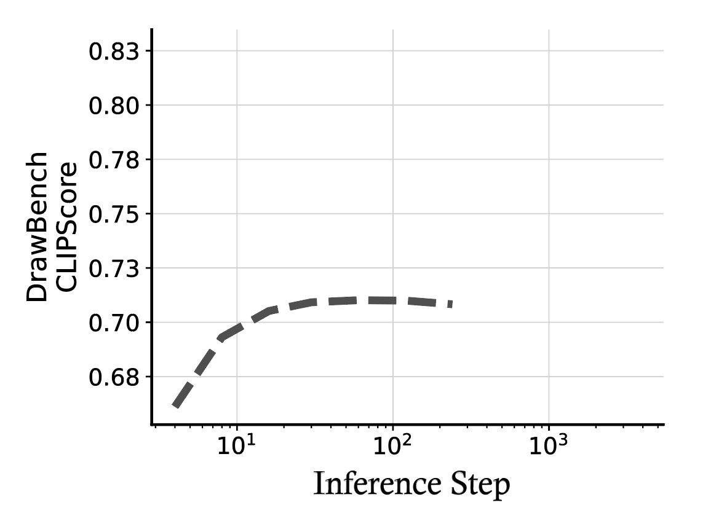
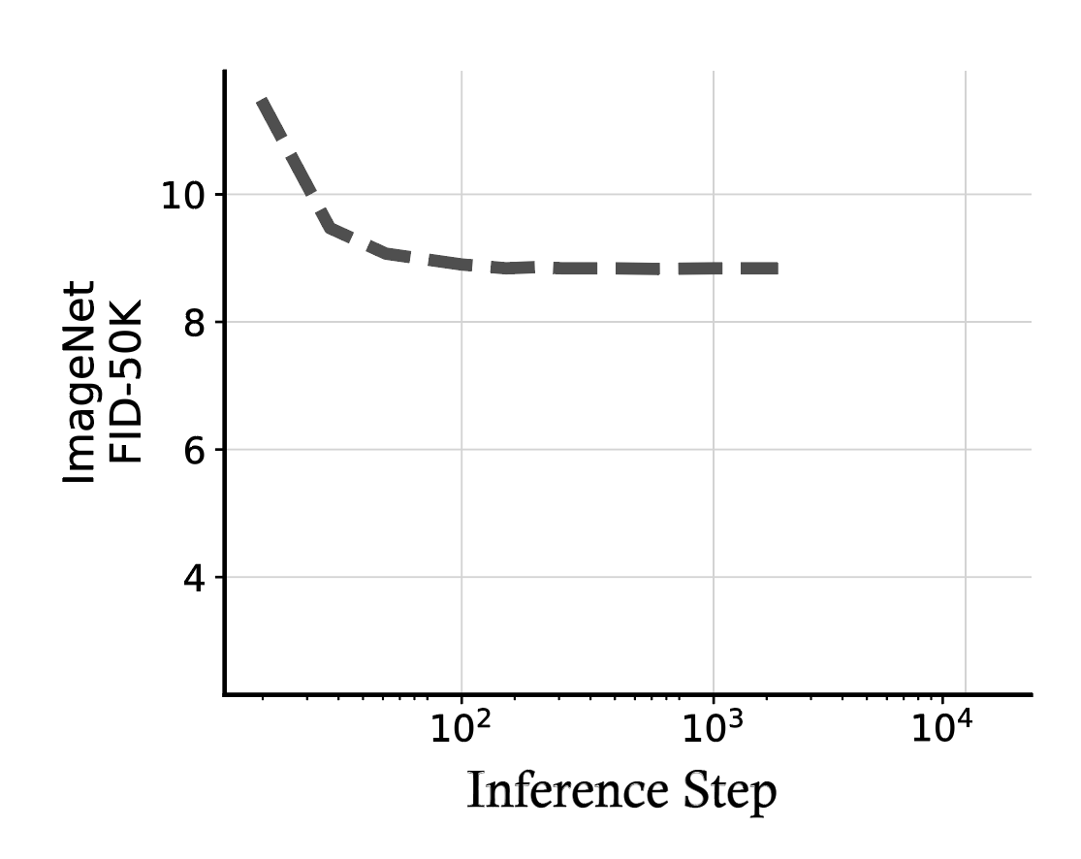
Problem Review
Diffusion models have attracted widespread attention for their ability to generate high-quality images, with many works focusing on improving performance by increasing training data, model size, and the number of denoising steps.
Inference-time Optimization (training-free) leverages existing pretrained models for post-processing to quickly enhance generation quality while avoiding the heavy computational cost of retraining. However, current inference methods that solely rely on increasing denoising steps often encounter a performance bottleneck, where further computational investment does not yield significant gains.

Slide 3
Method- Inference-Time Initial Noise Optimization
Instead of merely increasing the number of denoising steps, we can find better initial noise inputs by investing additional compute at inference time. The core idea is that by using extra compute to perform a guided search – where verifiers rate the candidates and various search algorithms are used – the overall generation quality can significantly exceed the performance achieved by merely scaling the denoising steps.
Framework:
1 - Verifiers: to measure the quality of noises/images
2 - Search Algorithms: to explore the noise space for better initial noise candidates.
3 - GPT Assistant : to provide a human-like score for noises/images

Slide 4










Method- Inference-Time Initial Noise Optimization
Local Verifiers
Initial Noise
Model Inference to generate image
Verifiers Ensemble
GPT Assistant
Framework:
1 - Verifiers
2 - Search Algorithms
3 - GPT Assistant
Search Algorithms
Final Image

Slide 5




Method- Inference-Time Initial Noise Optimization
Verifiers Ensemble
Aesthetic Score - Beauty
CLIP Score – Consistency
ImageReward Score - Holistic Quality
GPT Assistant Score - Human-like Insight
Average Rank

Slide 6
Method- Inference-Time Initial Noise Optimization
Search over Paths
By introducing perturbations along the sampling trajectory and evaluating the intermediate state images using verifiers, this method helps uncover potential improvements across the whole generation process.
Zero-Order Search
to generate multiple perturbed candidates within the local neighborhood of the current noise, then select the locally optimal candidate based on verifier scores.

Slide 7
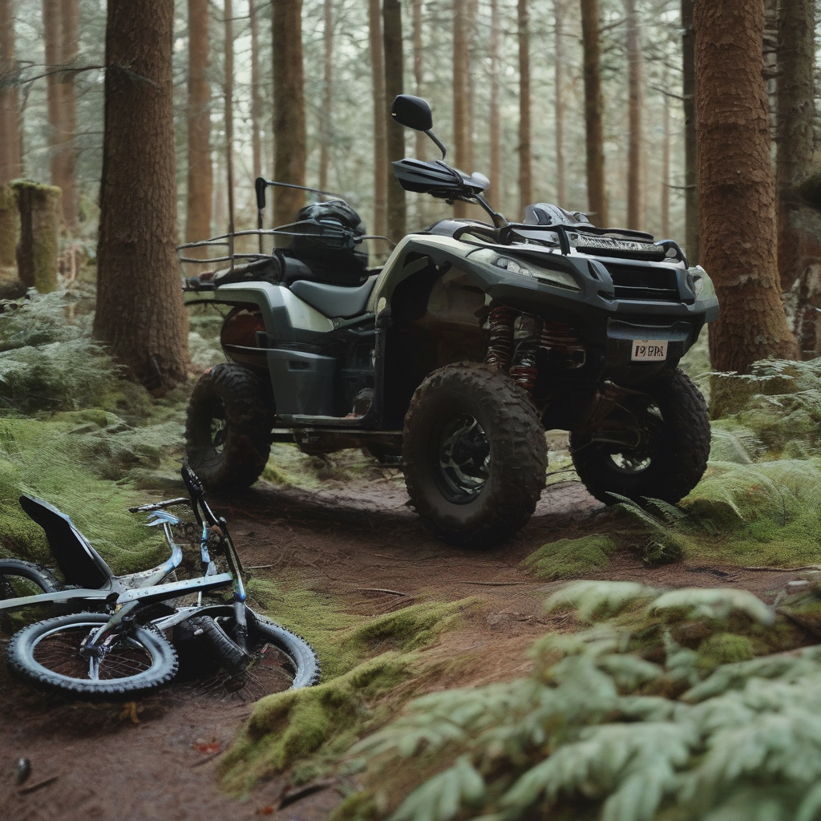

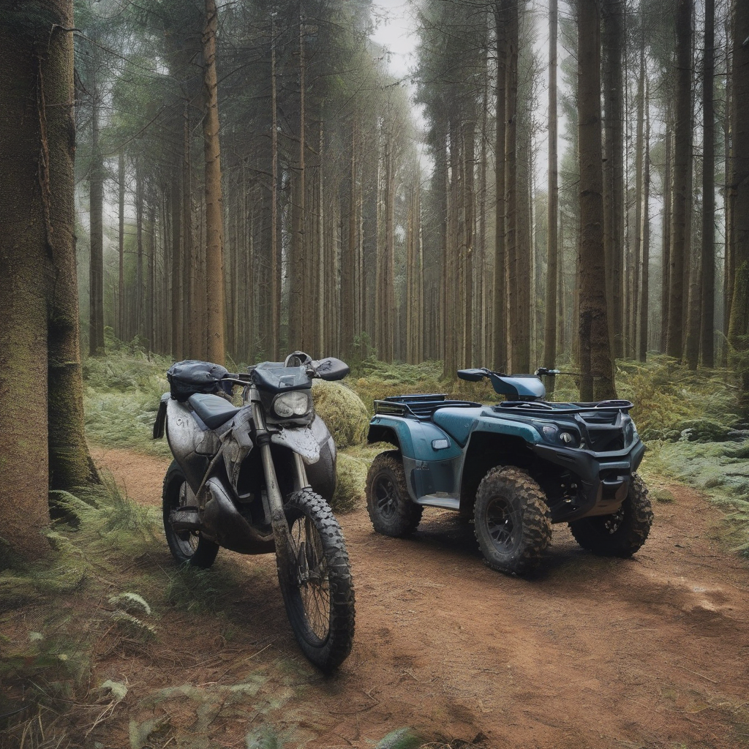

Experiment Result
Model = SDXL-base-1.0 Step = 30
Base
1.An off-road vehicle and
a bike in the forest
2.a beautiful landscape
painting
Proposed Method

Slide 8

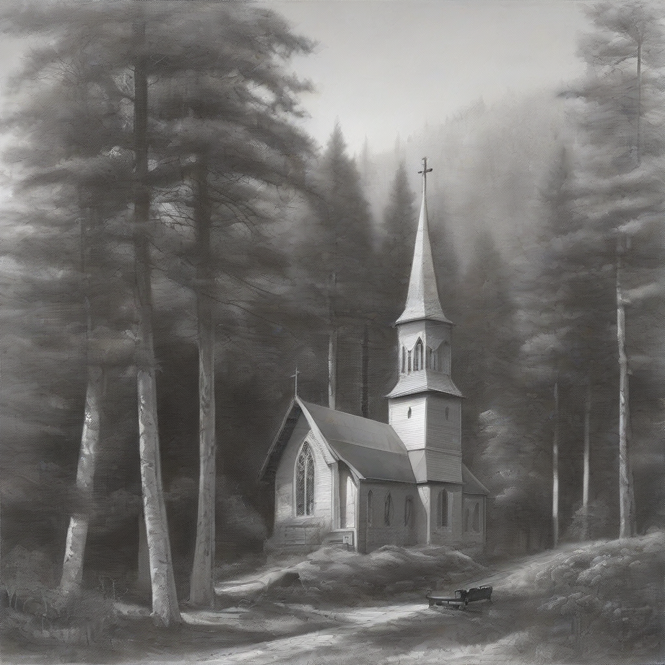


Experiment Result
Model = SDXL-base-1.0 Step = 30
Base
3.knight in armor, standing on
a cliff, looking at the sunset
4.a church in the forest
Proposed Method

Slide 9
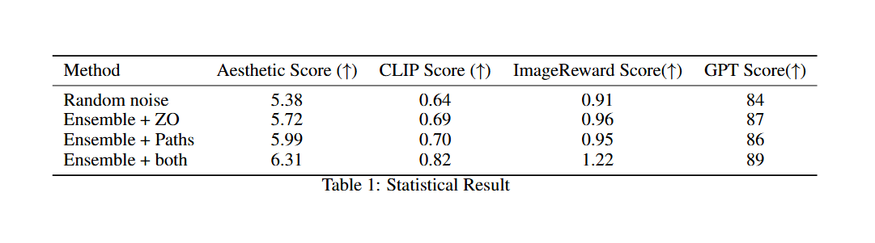
Experiment Result

Slide 10

Thank you

